Slide 1

Basic Electronics, an Intro’
Notes:
Norman Pomfret
Know something of Electronics
BUT Very Little of Raspberry PI’s

Slide 2
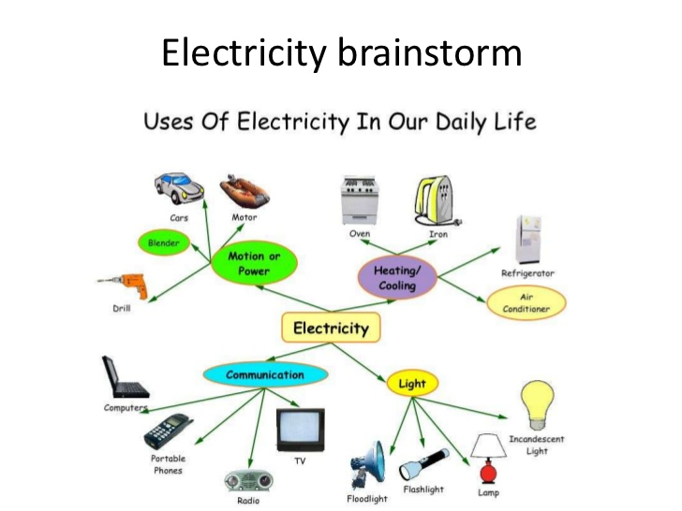
Notes:
You are Familiar with many of these
Perhaps you could not do without !!!
Electricity is working for you
Everywhere All the time Few Exceptions

Slide 3
Electricity is one form of Energy
Can’t Create or Destroy ENERGY
Can Transform Energy
Form one form to another form, eg Electricity to Heat, Light to Heat
Notes:
Energy is Indestructible
Easily Transformed into Heat
Now Rub your hands together ‘harder’

Slide 4
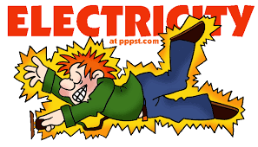
Electricity is Dangerous
Notes:
Electricity is Dangerous
You can not see IT sometimes the Effects Lightning
Do not be afraid, Be Respectful and Careful
Wire wool + Battery Demo

Slide 5
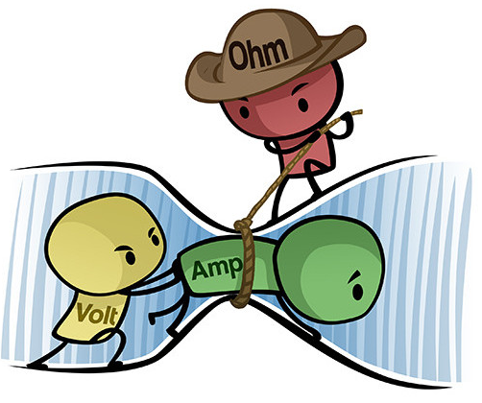
Electricity can be Compared to WATER flowing in a PIPE
Volt is the Pressure ‘Pushing’
The electric Current
‘Amp’
around the Circuit
Ohm is an obstruction ‘Resistance’
opposes Current Flow
Notes:
Water Analogy What makes Rivers Flow Easy option, not where you want
Pop Bottle No Bottom Marbles ???
Show Pipes Tap
What keeps the WATER in ?

Slide 6
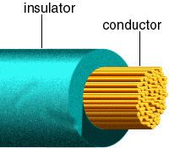
Conductors & Insulators
Notes:
Materials that Conduct and Don’t
Similar to Water Pipes
Show Examples of Cables

Slide 7
Electronics allows Control

Slide 8
What causes Current to Flow ?
Notes:
Show Copper Cables Wires
Consider a River, and a Lake No Pressure No Flow

Slide 9
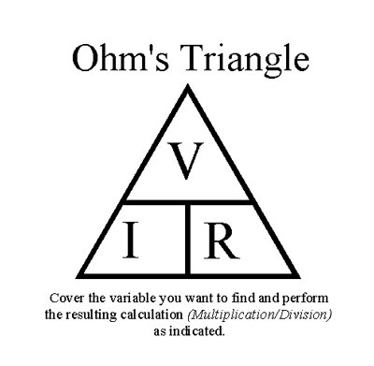
Voltage and Ohms Law
Notes:
Show examples
Power supplies
Batteries

Slide 10
Example
Power Supply 5 V
Current required 2.5 mA 0.0025 A
Resistance required :
Cover R, 5 / 0.0025 = 2,000 R
Simply
5 / 2.5 = 2 kR

Slide 11
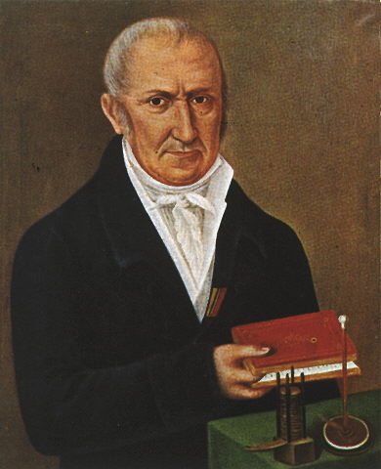
Volta
Alassandro Volta
1745 – 1827
Italian
Notes:
Physicist, Developed the First Battery to store Electrical Energy
Honoured by the Unit of Voltage measurement

Slide 12
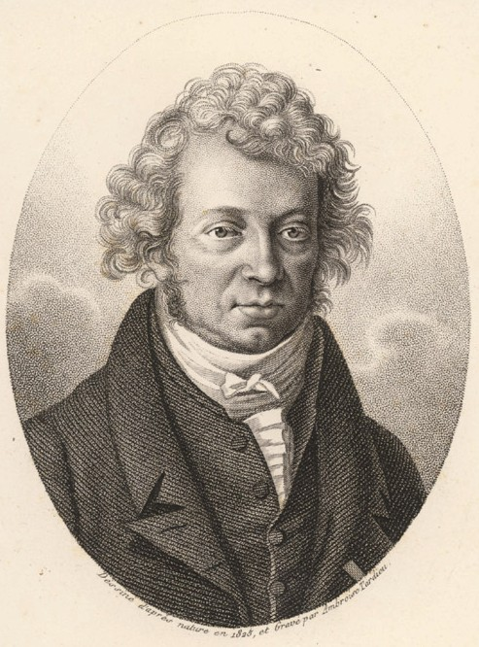
Ampere
Andre-Marie
Ampere
1775-1836
French
Notes:
Physicist,
Honoured by the Unit of Current measurement

Slide 13
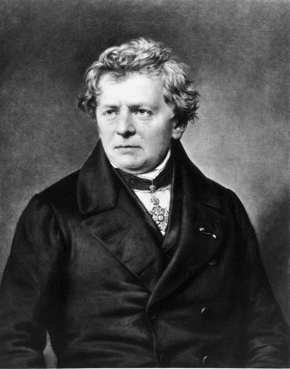
Ohm
Georg Ohm
1789 – 1854
German
Notes:
Physicist, Developed the relationship between Voltage and Current
Honoured by the Unit of Resistance measurement

Slide 14
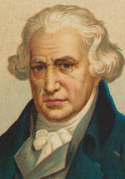
Watt
James Watt
1736-1819
Scottish
Notes:
Physicist, Developed and improved Steam Engines, increasing POWER output
Honoured by the Unit of Power measurement

Slide 15
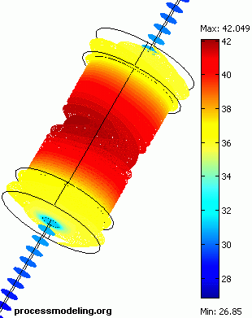
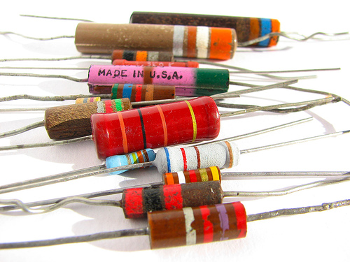
Resistors Regulate
Limit Current Flow
Dissipate Heat
Notes:
Demonstrate Cool & Hot Resistors
Domestic electric heaters

Slide 16
Power Dissipation (Heat)
Another Equation : ((
Power is
Voltage times Current, V x I
A Raspberry PI requires 5V at 1 A
Power requirement is 5 x 1 = 5 W

Slide 17
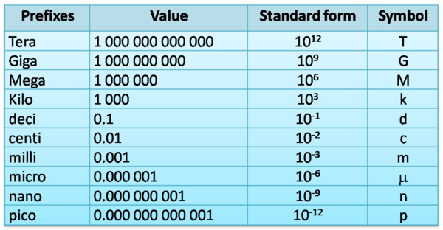
Mathematics
Notes:
Which are the Odd ones ?
Prefixes to state scale of size
Indices to state scale of size
Symbols shorthand don’t forget the Unit

Slide 18
Electronic Components
Electronics allows you to Control
Automate repetitive processes
Schedule processes at Time intervals

Slide 19
Electronic Components
Resistors
Diodes and Rectifiers
Light Emitting Diodes LED’s
Capacitors
Transistors
Relays

Slide 20
Resistors
Notes:
Show examples
Demonstrate use

Slide 21
Diodes and Rectifiers
Notes:
Show examples
Demonstrate use

Slide 22
Light Emitting Diodes
Notes:
Show examples
Demonstrate use

Slide 23
Capacitors
Notes:
Show examples
Demonstrate use

Slide 24
Transistors
Transistors in the context of PI’s are:
Electrically controlled switches
Where a small signal is able to allow a larger current to flow, in this mode the transistor is either ON or OFF i.e. a Switch
It is ‘binary’ either ON or OFF, no Halfway states
Notes:
Show examples
Demonstrate use

Slide 25
Relays
Are electrically operated switches
Allow your PI to Control Big Power devices
It is ‘binary’ either ON or OFF, no Halfway states
They are electro-mechanically operated switches
Notes:
Show examples
Demonstrate use
Relays must be ‘Quenched’ demonstrate ???

Slide 26
Sounders
Sounders emit Acoustic energy
by applying a Voltage across a Crystal
CAUTION
Never ever use a ‘Buzzer’ with your Raspberry Pi.
In addition to creating Sound they produce HIGH Voltages, can Destroy your PI
Notes:
Think about Ignition Coils on Petrol Engines
Demonstrate Back emf

Slide 27
Electronics further reading Reading
Adventures in Raspberry PI Carrie Philbin
Practical Electronics for GCSE 1989 but still relevant
Practical Electronics Complete Intro’ Andy Cooper
Electronics for Dummies Editorial Team
Raspberry PI Cookbook
Tim Cox

